Slide 1
“How can we wisely approach an unpredictable future?”
Clemens Wieland
Belgrade, June 12th, 2018

Slide 2



Agenda
01
02
03
Digitalization and its influence on the world of work
What does Digitalization mean for Vocational Education and Training?
Lessons
learned

Slide 3
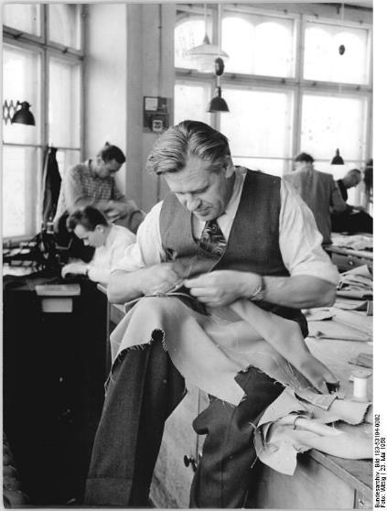
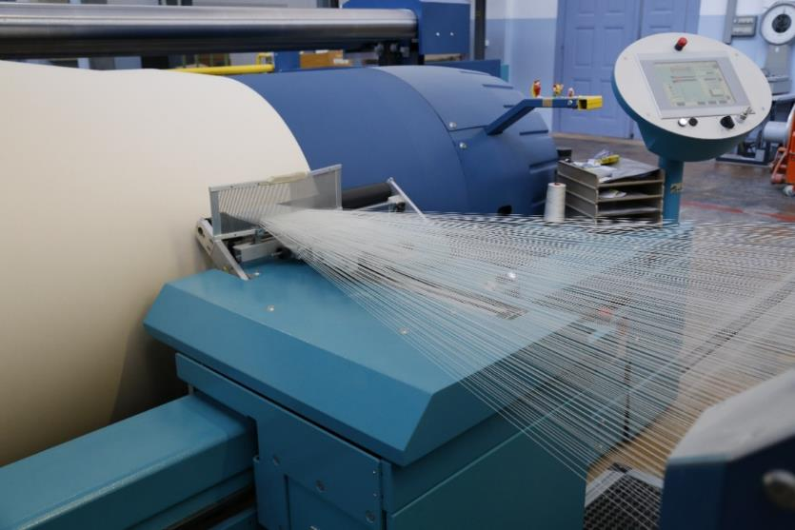
Example: Textile manufacturing through the ages
Picture credits: Bundesarchiv, Bild 183-53194-0002 / Wittig / CC-BY-SA 3.0; CC0 1.0 Universal
Notes:
Bildquellen:
Source (left foto): Bundesarchiv, Bild 183-53194-0002 / Wittig / CC-BY-SA 3.0 (https://commons.wikimedia.org/wiki/File:Bundesarchiv_Bild_183-53194-0002,_Gera,_"Modezentrum".jpg )
Source (right foto): CC0 1.0 Universal (https://pxhere.com/en/photo/849232)

Slide 4

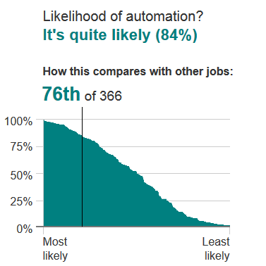
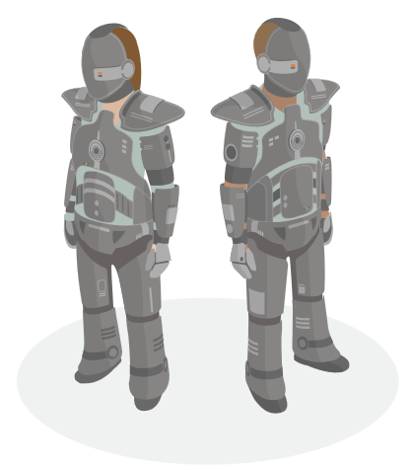
So, will a robot be doing your job in the future?
Source: http://www.bbc.com/news/technology-34066941

Slide 5
The trend is obvious:
Number of employed people in Germany in %
60%
Information services
50%
Agriculture
Manufacturing
40%
30%
Services
20%
10%
0%
Source: Dostal 1995
1880
1910
1920
1930
1940
1950
1960
1970
1980
1990
2000
2010

Slide 6



But bear in mind: Change is not a blueprint. It’s a journey.
Study results on the share of automatable jobs in %

Slide 7
Agenda
01
02
03
Digitalization and its influence on the world of work
What does Digitalization mean for Vocational Education and Training?
Lessons
learned

Slide 8


Two challenges for Vocational Education and Training in the light of digitalization
Economic performance:
How can we secure the need for skilled employees in an ever-changing world of work?
Equal opportunities:
How can we professionally qualify as many young people as possible in
view of the increasing requirements in
the world of work?
Picture credits: CC0 1.0; BSt/ Valeska Achenbach
Notes:
Bildquellen:
CC0 1.0 zu finden unter: https://pxhere.com/en/photo/763767 [CC0 1.0 Universal (CC0 1.0) no copyrights]
CC by BSt/ Valeska Achenbach

Slide 9
Economic performance:
How can we secure the need for skilled employees in an ever-changing world of work?
Picture credits: CC0 1.0 Univers

Slide 10


… by adapting existing and developing new professions
Examples for adaptation:
3-D printers for dental technicians
Use of drones in construction and agriculture
Use of Cyber-Physical Systems (CPS)
  Recommendation: Establishing IT as a key competence in every profession
smart factory
  Examples for development:
  IT management assistant
  IT systems technician
  Salesman for e-commerce
smart technology
Recommendation | Keep the institutional framework flexible for adaptation and development of new professions based on the requirements of the world of work.

Slide 11


… by keeping competences up to date
VET traditionally focusses on skills and know-how – but knowledge becomes obsolete faster and faster
Skill-based VET eases work entry.
However, know-how has an expiration date.
HIRED
Are your skills history?
Recommendation | Teach “learning to learn” instead of only accumulating know-how. Keep the system flexible for lifelong learning.
Picture credits: CC0 1.0
Notes:
Bildquellen:
Frau: CC0 1.0 zu finden unter: https://pxhere.com/de/photo/783783
Dino: CC0 1.0 zu finden unter: https://pxhere.com/de/photo/1152799 [CC0 1.0 Universal (CC0 1.0) no copyrights]

Slide 12
Equal opportunities:
How can we professionally qualify as many young people as possible in
view of the increasing requirements in
the world of work?
Picture credits: Valeska Achenbach

Slide 13

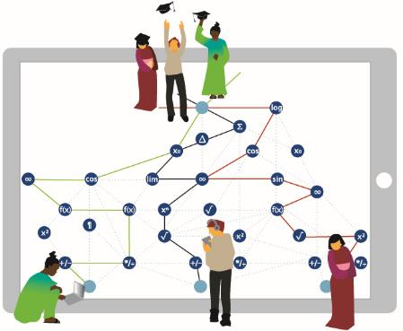
… by making way for new didactical approaches
Past: “one-dimensional”
textbook for all
Future: “more-dimensional
learning map” with individual paths
Chapter 1
Chapter 2
Chapter 3
….
Picture credits: Bertelsmann Stiftung
Recommendation | Use digitalization to give students the power to learn in the way they prefer (path), at their own pace and level (place).

Slide 14
… and shifting classroom paradigms by making teachers learning tutors and not only conveyors of knowledge
Traditional classroom
Flipped classroom
Lecture
Homework activities
Lecture
Classroom activities
Recommendation | Use small group instruction to empower students to develop critical thinking, communication and problem-solving skills.

Slide 15

… and by overcoming motivational barriers through gamification
Action
Motivation
Reward
Picture credit:CC BY-NC 2.0 licensed flickr photo shared by Joits
Recommendation | Use digitalization to develop new forms of learning.
Notes:
Picture credit:
CC BY-NC 2.0 licensed flickr photo shared by Joits (https://www.flickr.com/photos/joits/645044175/)
Abbildungen (Action, Reward): ???

Slide 16
Agenda
01
02
03
Digitalization and its influence on the world of work
What does Digitalization mean for Vocational Education and Training?
Lessons
learned

Slide 17
In a nutshell: How to approach an unpredictable future
1) | Keep the institutional framework flexible for adaptation and development of new professions based on the requirements of the world of work.
2) | Teach “learning to learn” instead of only accumulating know-how. Keep the system flexible for lifelong learning.
3) | Use digitalization to give students the power to learn in the way they prefer (path), at their own pace and level (place).
4) | Use small group instruction to empower students to develop critical thinking, communication and problem-solving skills.
5) | Use digitalization to develop new forms of learning.

Slide 18
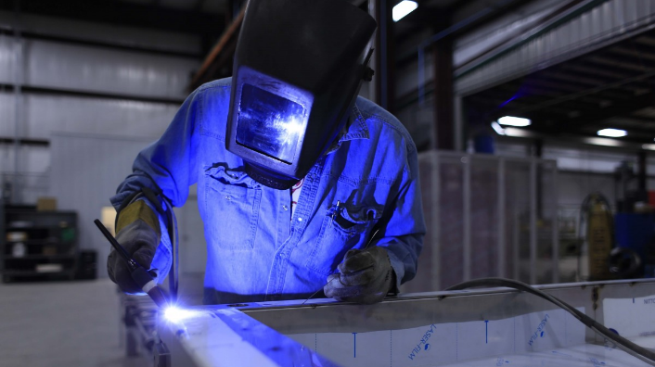
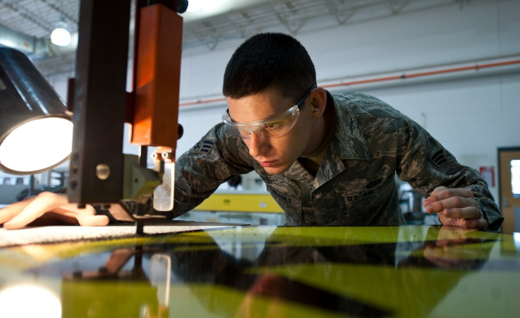

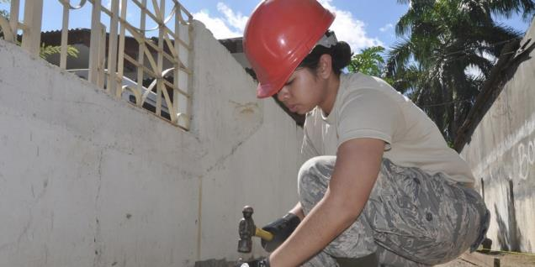
Food for thought:
Dual education has a head start in terms of digital competences compared to other forms of education:
Doing an apprenticeship in a company with an economical interest in using state-of-the-art technology, is clearly beneficial.
Notes:
https://pxhere.com/de/photo/747034
https://pxhere.com/de/photo/749546

Slide 19






Clemens Wieland
Senior Project Manager
Program Learning for Life
Bertelsmann Stiftung
Phone: +49 5241 81-81253
Fax: +49 5241 81-681253
E-Mail: clemens.wieland@bertelsmann-stiftung.de
E-Mail: LL-News@bertelsmann-stiftung.de
Please visit us on
/en

Slide 20
References:
Frey/Osborne (2014) The future of employment: How susceptible are jobs to computerisation?
https://www.oxfordmartin.ox.ac.uk/downloads/academic/The_Future_of_Employment.pdf
Bowles, J. (2014) The computerisation of European jobs
http://bruegel.org/2014/07/the-computerisation-of-european-jobs/
Bonin, H., Gregory, T., & Zierahn U. Übertragung der Studie von Frey/Osborne (2013) auf Deutschland (2015)
ftp://ftp.zew.de/pub/zew-docs/gutachten/Kurzexpertise_BMAS_ZEW2015.pdf
Dengler, K. und B. Matthes (2015) Folgen der Digitalisierung für die Arbeitswelt
http://www.iab.de/185/section.aspx/Publikation/k151209302
Brzeski, C.; und I. Burk (2015) Die Roboter kommen Folgen der Automatisierung für den deutschen Arbeitsmarkt
https://www.ing-diba.de/pdf/ueber-uns/presse/publikationen/ing-diba-economic-analysis-die-roboter-kommen.pdf
Buch, T. , K. Dengler und B. Mattes (2016) Saarland, Thüringen und Baden-Württemberg haben den größten Anpassungsbedarf
http://doku.iab.de/kurzber/2016/kb1416.pdf
Arntz, M., T. Gregory und U. Zierahn (2016) The risk of automation for jobs in OECD countries
https://www.oecd-ilibrary.org/docserver/5jlz9h56dvq7-en.pdf?expires=1527599638&id=id&accname=guest&checksum=7253A10BA6663200162E880AF3A34AF7

