Slide 1
Work based learning: a road to opportunities
Thomas Mayr
Belgrade, 12 June 2018

Slide 2
Great differences in the prevalence of VET and of work based training across the OECD

Slide 3
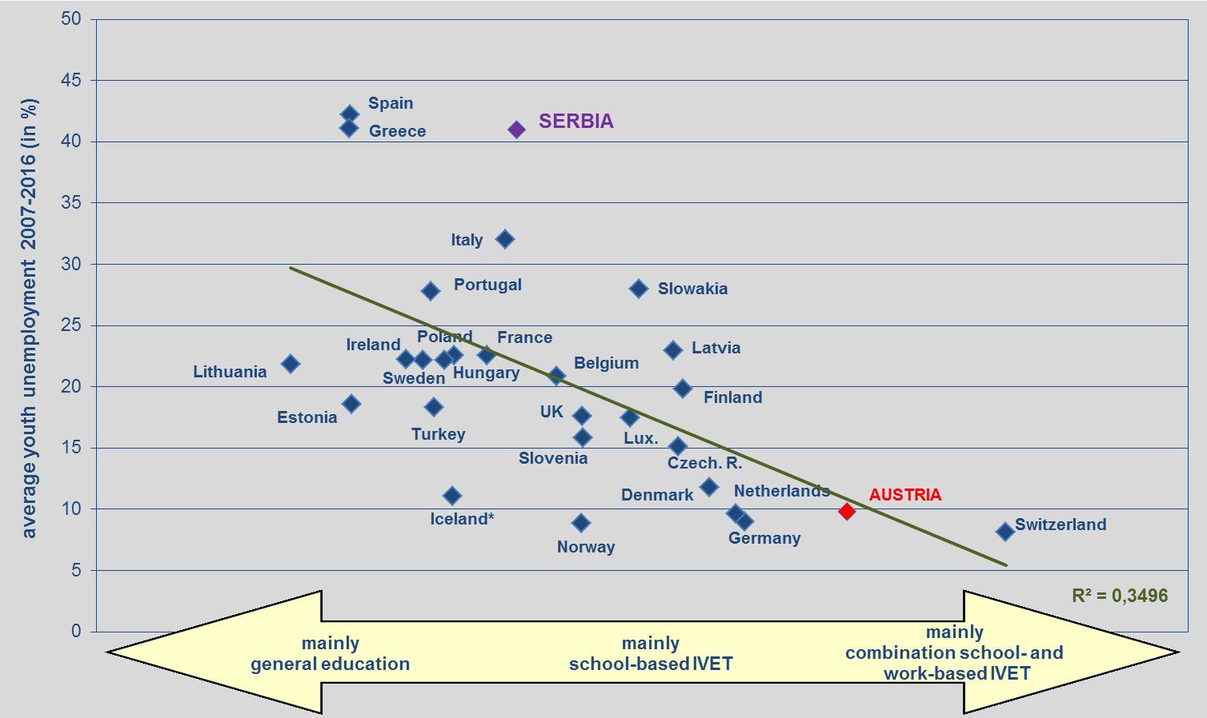
Dual VET works: average rates of youth unemployment and type of education and training 2007-2016
Source: OECD & Eurostat data; for Serbia: Trading Economics

Slide 4



Challenges and main policy questions
→ How to make dual VET attractive for individuals?
→ How to make it attractive for companies to engage in dual VET?

Slide 5





Relevant dimensions of work based learning
→ responsiveness to companies’ skills needs
  supply led approach versus demand led approach
→ business case for companies
  catalysts: institutions and governance structures that allow “co-ownership”;
  company perspective in qualification design
  practical and financial support for companies
→standards and qualifications
  professions versus jobs
→ the place of VET in the overall education system
  dual VET embedded in overall education system
  progression routes
→ mechanisms of quality assurance
  regulatory framework with clearly defined responsibilities
  feedback mechanisms
Vgl. Wolfgang Bliem, Kurt Schmid, Alexander Petanovitsch (2014): Erfolgsfaktoren der dualen Ausbildung. Transfermöglichkeiten ibw-Forschungsbericht Nr. 177

Slide 6
European Framework for Quality and Effective Apprenticeships (1)
Criteria for learning and working conditions
Written contract between employer, the apprentice and the training institutions.
Learning Outcomes should ensure both job-related skills and personal development
Pedagogical support: in-company trainers should be designated; cooperation between trainers and teachers
Workplace component: at least 50% of the duration should take place at the workplace.
Remuneration: Apprentices should be paid.
Social Protection: Apprentices should be entitled to social protection including insurance.
Work, health and safety conditions: The workplace should comply with relevant rules and regulations on working conditions, in particular health and safety legislation.
Source: Council Recommendation of 15. March 2018 on a European Framework for Quality and Effective Apprenticeships (2018/C 153/01): Summary by TM

Slide 7
European Framework for Quality and Effective Apprenticeships (2)
Criteria for Framework conditions
Regulatory framework based on partnership and dialogue between stakeholders. This may include accreditation procedures for companies.
Involvement of social partners in the design, governance and implementation of apprenticeship schemes.
Support for companies: financial and/or non-financial support should be envisaged, enabling cost-effective apprenticeships for companies.
Flexible pathways and mobility: Apprenticeship should lead to a nationally recognised qualification. Apprenticeships should allow access to higher education and training levels. Transnational mobility should be promoted.
Career guidance and awareness raising: Learner support before and during the apprenticeship.
Transparency: Transparency and access to apprenticeship offers should be ensured.
Quality assurance and graduate tracking: There should be quality assurance of apprenticeships and tracking of employment of apprentices.
Source: Council Recommendation of 15. March 2018 on a European Framework for Quality and Effective Apprenticeships (2018/C 153/01): Summary by TM

Slide 8
ibw Austria - Research & Development in VET
Rainergasse 38
1050 Wien
www.ibw.at
info@ibw.at

