Slide 1
WG on VET Permeability
VET Conference: WBL – a road to opportunities
Belgrade, 12th June 2018
© ibw 2018
Kurt Schmid
schmid@ibw.at

Slide 2
Permeability
vertical versus horizontal
access and continuation / career => IVET & CVET
  general education versus IVET / second chance options
  educational pathways (Higher Education) & employment careers
Goals – permeability to …
… foster equal opportunities
… give second chance options
… foster attractiveness of IVET
… broaden access to HE
… foster upward skilling of workforce
accreditation of non-formal and/or informal competencies
… raise transparency of education system

Slide 3
3 examples in brief
AUSTRIA’s VET colleges & its Berufsreifeprüfung
VET Colleges: give access to general HE (like gymnasia / Maturita)
Berufsreifeprüfung (BRP): since 1997 for apprenticeship or VET school graduates; external exam that gives general access to HE (“HE entrance examination”)
subject-specifivc access to universities of applied science
SWISS tertiary B as integral part of the HE-system
Higher VET is organised as a specific sector within the HE-system
IVET graduates have preferential access to Higher VET
AUSTRIA: nexus between occupation & formal qualification

Slide 4

Austria’s Educational System
(simplified version)
Notes:
40% Maturantenquote
17% AHS Maturanten gehen innerhalb ersten 3 Jahre auf Uni
50% BHS-Maturanten gehen innerhalb ersten 3 Jahre auf Uni

Slide 5
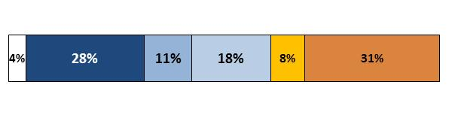
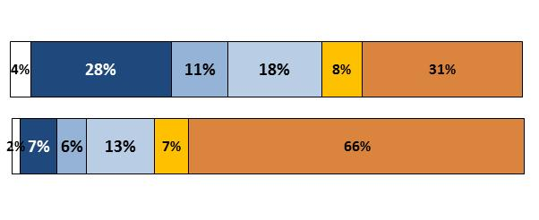
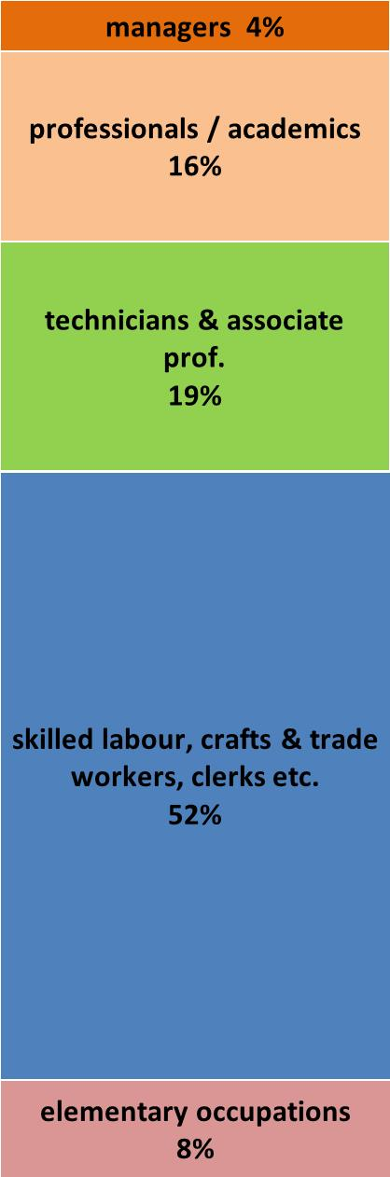
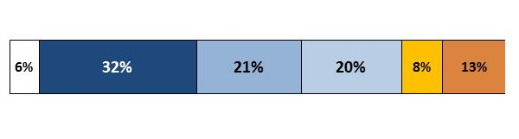
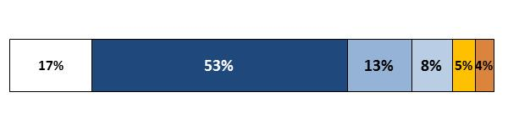
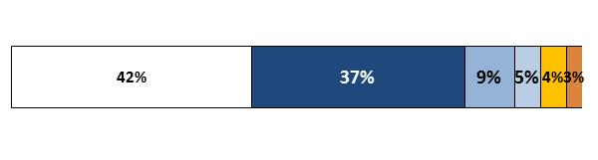
Austria‘s occupation structure (ISCO)
and the share of different qualifications within each job category
Source: LFS 2013

Slide 6
Lessons learned - discussion
GOALS envisaged: Why fostering permeability in Serbia?
WAYS/OPTIONS: How to foster permeability in Serbian IVET?
Role of companies?

Slide 7
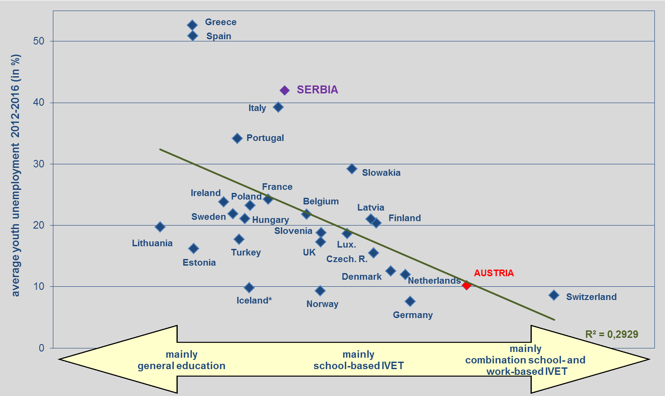
IVET & youth unemployment
Source: OECD & Eurostat data; for Serbia: Trading Economics

