Slide 1
Quality Management in Education
Implementation of the Business Excellence Model in VET
School of Economy and Commerce of Bečej
Gordana Kovačev
Principal of the School of Economy and Commerce of Bečej

Slide 2
Preconditions for the Implementation of the Business Excellence Model in the School of Economy and Commerce of Becej
In year 2002 School of Economy and Commerce has joined the project „Reform of Vocational Education and Training in Serbia“ implemented by Ministry of Education of RS and GIZ
Development of new profiles
Intensive teacher training
Intensive equipment of school
IT-implementation in classes

Slide 3
Regional Project Competence Centers in Serbia- ReCeKo
    Developing a new school statute
    Revision of vision, mission and values of school
    Defining a new organizational structure
    Setting up a team for quality management and naming a leader for the quality of developing documentation for the quality system
    Defining of the process, developing the process map and description of processes
    Yearly self-evaluation based on the EFQM Excellence Model

Slide 4
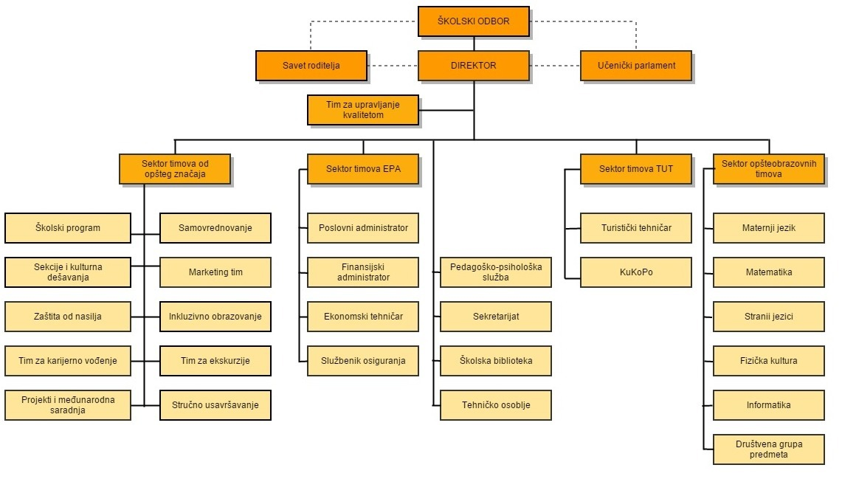
Organizational Structure of the School of Becej

Slide 5
Documentation of the management system
Management handbook, procedures, guidelines, records, forms
QM STAR electronic platform for file management

Slide 6
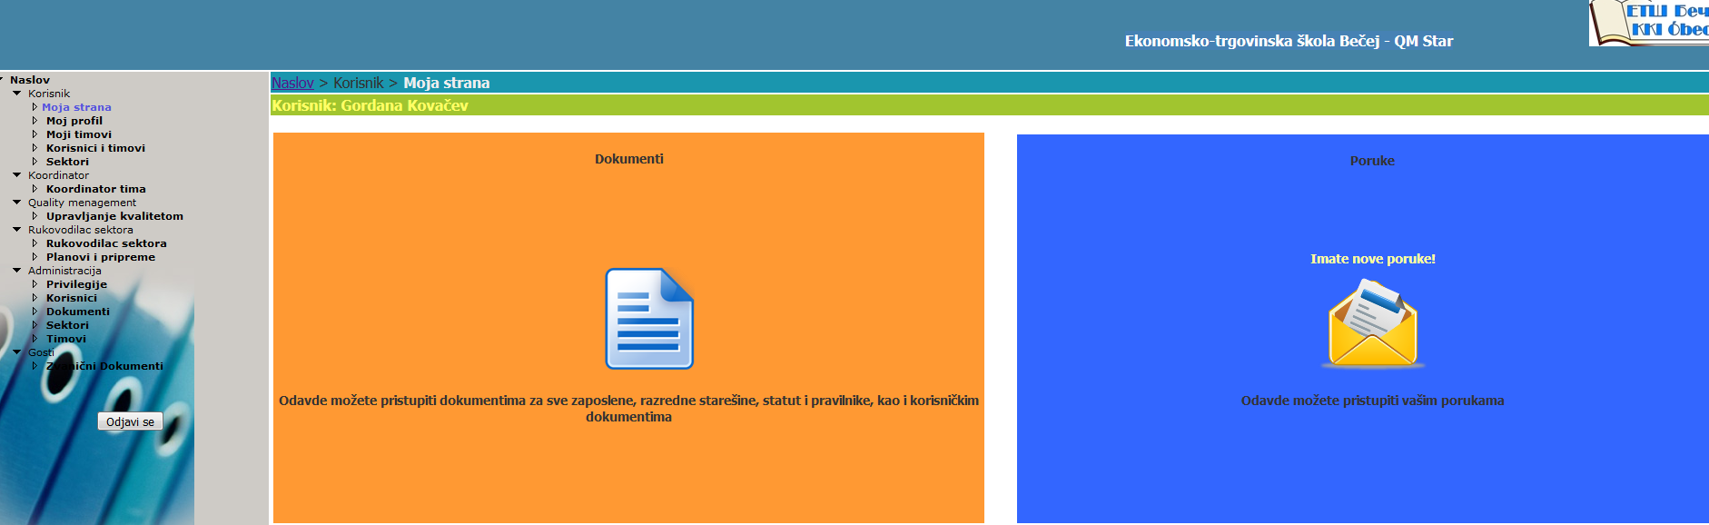
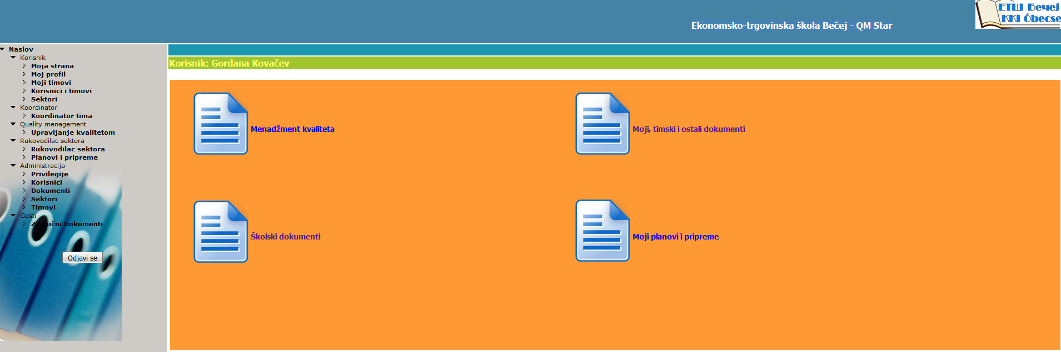

Slide 7
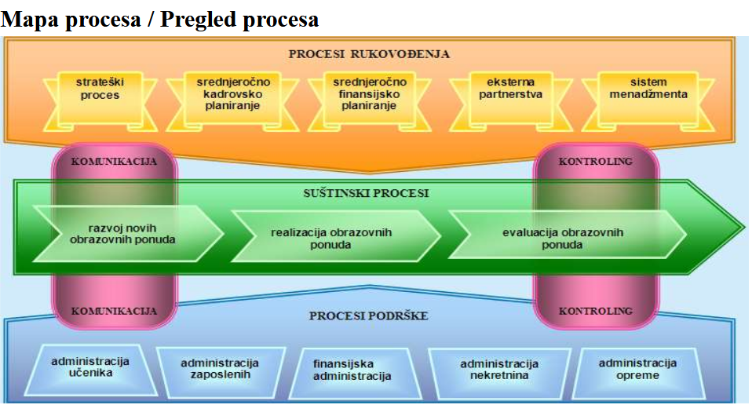

Slide 8
What was the use of the change?
New, clearly defined organizational structure has given a clear framework for division of tasks and duties/responsibilities
Identification of the process, developing a process map, distribution of processes to their owners, job descriptions have also helped to divide the working tasks adequately and to control them
Setting up a documentation system gives a clear frame and instructions to employees in performing their tasks and a more efficient control system
Management by goals on all levels has enabled a clear division of tasks, measurable effects of work, both in the teaching process and in other activities at school
Implementation of the Document Management System (DMS) has enabled employees an access to school documentation at any moment, from any place at school and outside. Major savings have been made in the costs of copying and archiving of documents, communication has been improved among the employees, and the principle has become a more clear picture of the productivity of employees and a higher degree of control on the performed tasks
All the above stated has helped the school to become more efficient, and our students to get a higher quality of education. More over, closer and better connections have been established to our social partners.

Slide 9
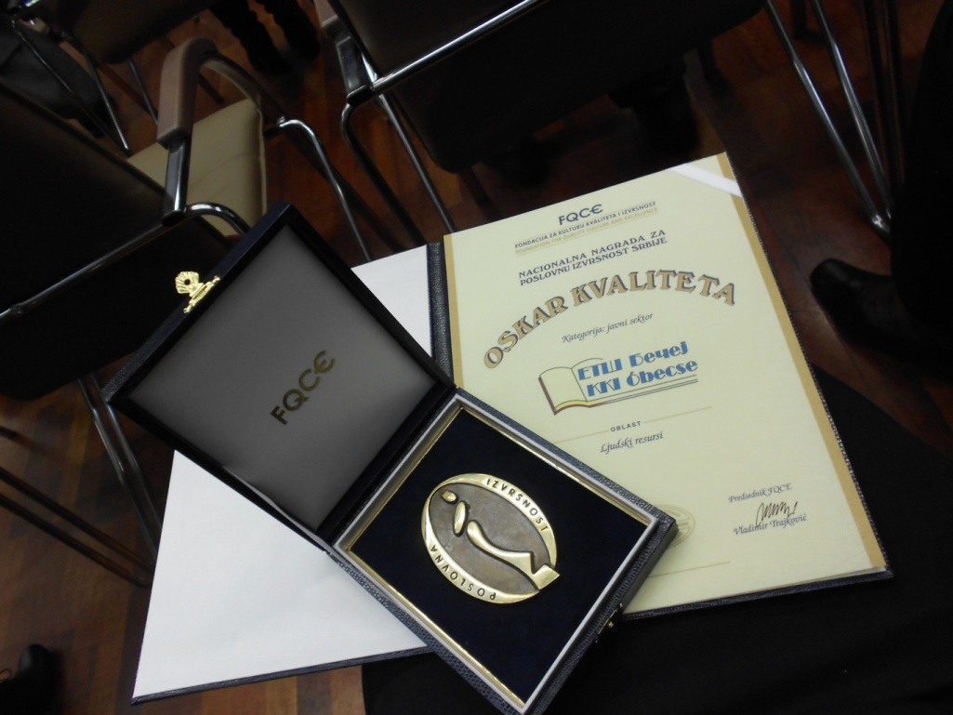
What was the use of the change?
In the external evaluation of the Ministry of Education of RS our school has got the highest grade
The National Reward for Business Excellence of Serbia – 2014 Quality Oscar awarded by the Foundation for the Quality Culture and Excellence (FQCE)

Slide 10
Thank you for your attention

